Slide 1

Disaster Risk Reduction Planning with Local Government
Cadiz City, Negros Occidental, Philippines

Slide 2
This process is based on Tearfund’s experience in the Philippines, in response to Typhoon Haiyan (2013). This presentation was created to help local government, civil society organisations and communities who are interested in developing a disaster risk reduction (DRR) plan. Our experience in Cadiz City may be different from your area and therefore we would encourage you to adapt this process to suit your needs.
For more information please contact humanitarian.support@tearfund.org

Slide 3
1. Introduction

Slide 4
1.1 What is Disaster Risk Reduction?
“The concept and practice of reducing disaster risks through systematic efforts to analyze and manage the causal factors of disasters, including through reduced exposures to hazards, lessened vulnerability of people and property, wise management of land and the environment, and improved preparedness for adverse events”
(Philippine Disaster Risk Reduction and Management Act of 2010)
Notes:
As defined by the Philippine Disaster Risk Reduction and Management Act of 2010, the term “disaster” is a serious disruption of the functioning of a community or a society. This involves “risk” or the probability of widespread human, material, economic or environmental losses and impacts which exceeds the ability of the affected community or society to cope using its own resources.in the future. Thus, there is a need to minimise risk by reducing losses so that the limited available resources in a community or society can be allocated further to development initiatives.
To effectively manage this risk, there is a need to analyse the underlying factors that cause disasters. Various literature in disaster research points to disaster risk as a combination of hazards (the natural and human-induced dangers that may cause disruptions), vulnerability (the characteristics of a community that make it susceptible to damages brought by hazards, like socio-economic factors, physical infrastructure and education level), exposure (elements that likely to experience the hazards) and capacity (strengths and resources present in the community).
As the World Risk Index report in 2013 points out: “A country’s risk of becoming the victim of a disaster is not determined solely by its exposure to natural hazards, but to a crucial extent also by the society’s state of development.”

Slide 5
1.2 What is included in a disaster risk reduction plan?
Identification of hazards, vulnerabilities and risk to be managed
Disaster risk reduction and management approaches / strategies
Agency roles, responsibilities and lines of authority
Coordination in pre-disaster and post-disaster phases
Budgetary resources
(Philippine Disaster Risk Reduction and Management Act of 2010)
Notes:
A plan serves as a guide to achieve sustainable development. It highlights the importance of mainstreaming disaster risk reduction in the development process. This involves various facets of governance, socio-economic planning, policy setting, community involvement and partnerships, and financial management (Plan International, 2011).

Slide 6
1.3 Why make a DRR plan?
Guide national government to allocate 5% of the local government budget to DRR
Help the community access funding from national government
Strengthen local government’s technical capacity in disaster management
Identify infrastructure priorities and action plans in anticipation of severe hazard events
Train local actors in preparing for disasters, to promote safe and resilient communities

Slide 7
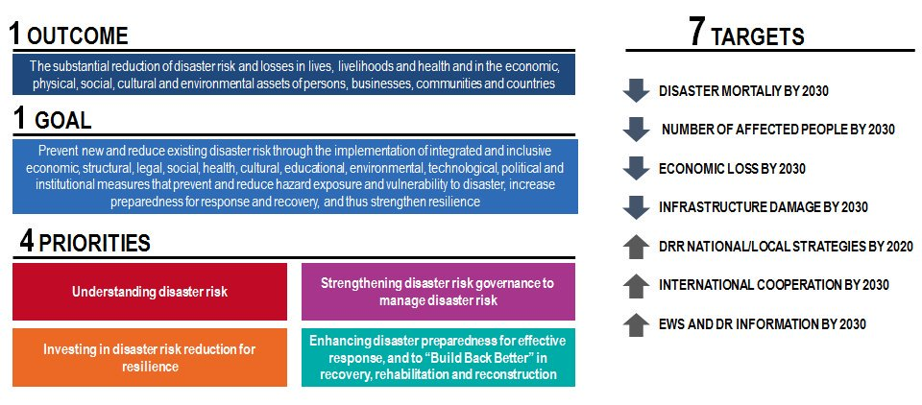
1.4 Sendai Framework of Action
Notes:
The Sendai Framework of Action for Disaster Risk Reduction 2015-2030 is an international agreement that underscores the role of governments in reducing losses due to disasters. This also emphasises the need for inclusion and cooperation of different stakeholders (eg. Private sector) in pursuing a sustainable development agenda (UNISDR, 2015).
Realising that different communities face varying risks and the immediate need to attend to such, the Sendai Framework calls for strengthening the capacities of local governments for laying strategies in disaster risk reduction and management. It points to local government’s role in pursuing four priorities of actions to achieve the seven identified targets of the framework.

Slide 8
1.5 Disaster Risk Reduction Framework
Prevention and Mitigation
Preparedness
Adapted from the National Disaster Risk Reduction and Management Framework of the Philippine Government
Recovery and Rehabilitation
Response
Notes:
The Philippine government developed a national disaster risk reduction and management framework that rests on four pillars, namely:
Disaster Prevention and Mitigation (spearheaded by the Department of Science and Technology)
Disaster Preparedness (led by the Department of Interior and Local Government)
Disaster Response (with the Department of Social Welfare and Development at the helm), and
Disaster Recovery and Rehabilitation (primarily steered by the National Economic and Development Authority)
This framework relies that there will be lessons learned in each disaster events which can be then used to improve the government’s plans and protocols. It is envisioned that will lead into an eventual adoption of a proactive approach that focuses on prevention and mitigation and preparedness from a previous reactive attitude focusing on response, recovery and rehabilitation.
This approach is primarily based on economics. Based on observations made by former Federal Emergency Management Agency head James Lee Witt, “every dollar spent on mitigation is five dollars saved” (that should have been spent on response and recovery) (Holloway, as quoted by Goodyear, 2013)

Slide 9
2. Getting Started: Organising and Mobalising

Slide 10
2.1 Overview of activities
Consultation with the Local Chief Executive, Local Disaster Risk Reduction and Management Council, and other stakeholders
Identify and mobalise members of Advisory Panel and Technical Working Group
Orientation on Disaster Risk Reduction and Climate Change Adaptation
Review of the Sendai Framework, Laws on Disaster Risk Reduction and Climate Change Adaptation
Review of the National and Local Disaster Risk Reduction Plans
Set up work plan and timeline
Preparation of ecological profile and socio economic, hazards, vulnerability data

Slide 11
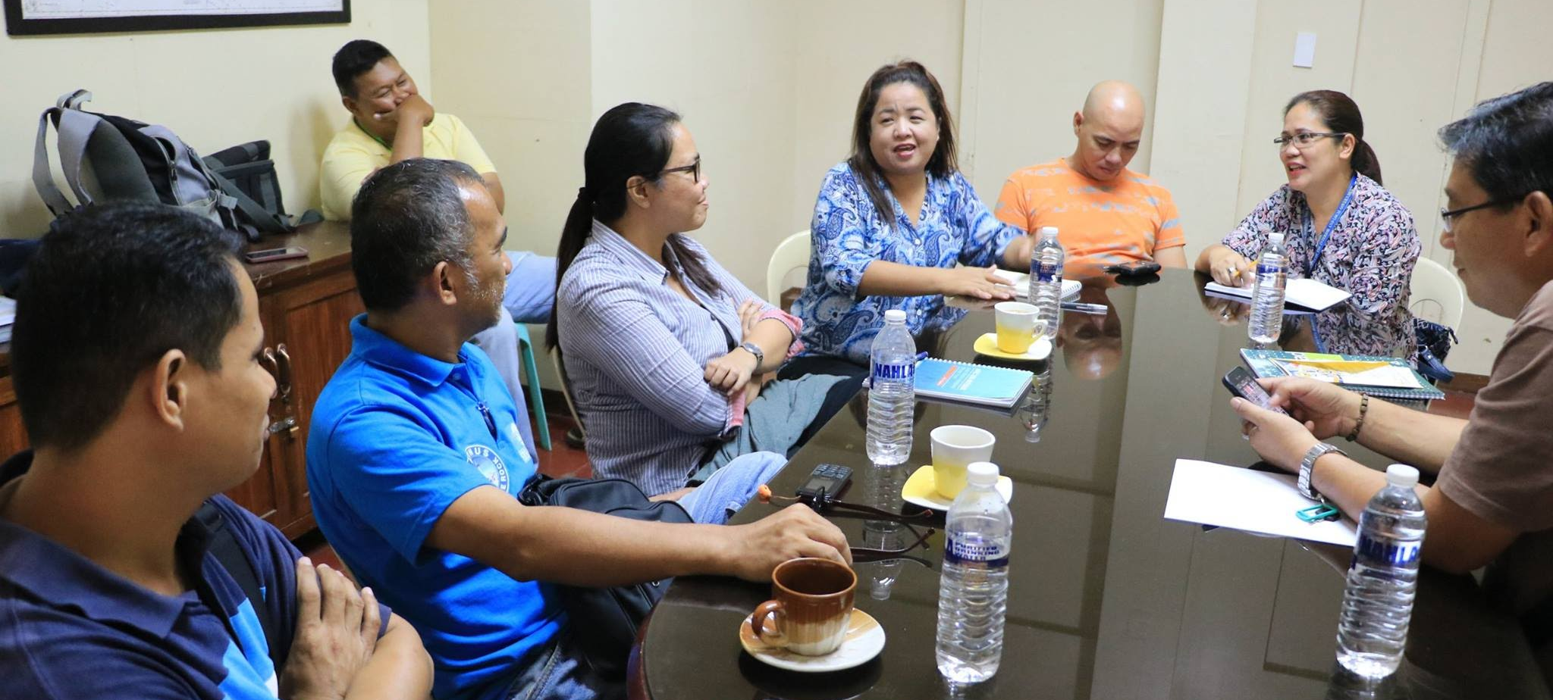
2.2 Consultation with key stakeholders
Cadiz City Government, 2016
Notes:
The revision/creation of a local disaster risk reduction and management (DRRM) plan starts by initialising a series of meetings to “get the ball rolling”.
Engaging the Local Disaster Risk Reduction and Management Council/Office will be crucial in this endeavor as the said department will serve as the point person for the whole process. They can provide you with the baseline information (existing DRRM plans and protocols and other pertinent information on risk elements) for the community.
Securing the buy-in of local chief executives and other local government officials is also crucial in the succeeding phases of the process. They can provide valuable support to facilitate information sharing, and in the eventual mainstreaming of disaster risk reduction.

Slide 12
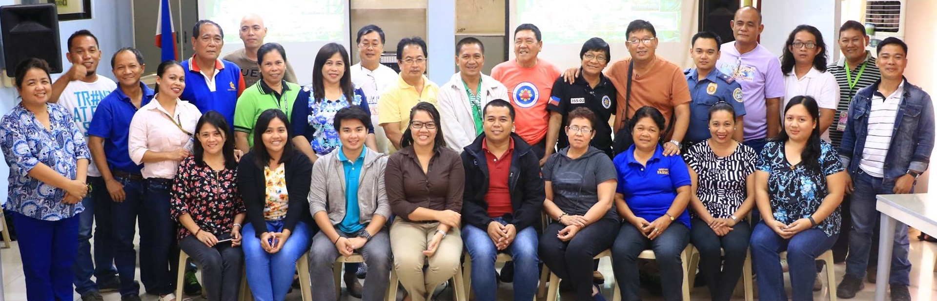
2.3 Identification & mobilisation of Advisory Panel and Technical Working Group
Cadiz City Government, 2016
Notes:
The Local Disaster Risk Reduction and Management Council can then identify members (inside the local government and the community) to sit on the Advisory Panel and Technical Working Group.
With the support of the local chief executive, other prospective members (usually coming from outside the immediate community) of the above-mentioned bodies can be invited.
It is expected that this could lead to fostering partnerships and cooperation in ensuring safety and resilience.

Slide 13
2.3.1 Advisory Panel
Members
Technical Consultants
Policy & Advocacy Specialists
Representatives of National Disaster/ Emergency Agencies
Government bureaus involved in Hazard Mapping
Local Civil Society Organisations
Partner Educational Institutions
Tasks
Meets monthly to discuss the proposed action plans
Informs the team on national and international scenarios
Advises on hazard & risk scenarios and policy & advocacy at the local level
Notes:
If resources permit, the local government can involve consultants to provide technical expertise on disaster risk reduction (DRR) and climate change adaptation (CCA).
Provincial, regional and national government representatives should also be involved to ensure concurrence and harmonisation with plans prepared at provincial, regional and national levels.
By involving government agencies in hazard mapping and warning, the plan can be attuned to a more systematic approach in disaster mitigation and preparedness. Through partnership with academics (such as nearby universities and colleges), more avenues in improving scientific information and education can be introduced.
Lastly, involving civil society organisations can give voices from the community, leading to a plan that can be “owned” by the community.

Slide 14
2.3.2 Technical Working Group
Members
Local Disaster Risk Reduction Management Council members
Local Government Departments
Representatives from National Government Agencies
Academics
Geographic Information Systems (GIS) Experts
Tasks
Provides technical perspective in drafting of the plan
Facilitates the development of projects under the DRRM Programme, both at the city and barangay level
Meets twice-monthly to coordinate planning activities
Notes:
The technical working group members mainly come from the different departments of the local government unit. It can also involve representatives of partner organisations and institutions as well to make the process more inclusive.
Geographic Information Systems facilitates a systematic and efficient method of analysing different disaster risk elements. An evidence based approach and data-driven plan can be produced, by utilising this technology, maps, lists, tables and statistical information viable.

Slide 15
2.3.3 Technical Working Group - Thematic Areas
Disaster Prevention
and Mitigation
Preparedness
Response
Rehabilitation
and Recovery
  Knowledge management, social protection & public health
  Agriculture resilience
  Early warning system, barangay digitised hazard mapping
  Networking
  Monitoring and evaluation of DRR plan and its implementation
  Pre-disaster Risk Assessment
  Community Risk Assessment
  Policy Advocacy
  Community Risk Assessment
  Policy Advocacy
  Incident Command System Training
  Evacuation Plan
  Organise accreditation of community disaster volunteers, relief stockpiling
  Perform emergency drills
  Purchase of emergency response related equipment
  Prepare Emergency Response Standard Operating Procedure
  Prepare contingency plan
  Link with NEDA and other institutions (e.g. INGOs)
  Evacuation Infrastructure
  Housing
  Livelihood
  Food and water security
  WASH
Notes:
The technical working group can be divided into groups that mirror the disaster risk reduction and management framework. Ideally, departments and offices directly involved in various activities related to each pillar should be a member of each sub-group

Slide 16
2.3.4 Technical Working Group - Sample Composition
Disaster Prevention
and Mitigation
Preparedness
Response
Rehabilitation
and Recovery
  Chair:
  Planning and Development Office
  Members:
  Fire Department
  Community Environment and Natural Resources Office
  Engineering Department
  Social Welfare Office
  Veterinary Office
  Agriculture Office
  Health Department
  Rescue Teams
  Local School Board
  Utility Companies
  Civil Society Organisations
  Chair:
  Local Emergency Organisation
  Members:
  Fire Department
  Police Department
  Planning and Development Office
  Engineering Department
  Social Welfare Office
  Veterinary Office
  Agriculture Office
  Health Department
  Rescue Teams
  Local School Board
  Utility Companies
  Civil Society Organisations
  Chair:
  Social Welfare Office
  Members:
  Fire Department
  Police Department
  Planning and Development Office
  Engineering Department
  Social Welfare Office
  Veterinary Office
  Agriculture Office
  Health Department
  Rescue Teams
  Local School Board
  Utility Companies
  Civil Society Organisations
  Chair:
  Engineering Department
  Members:
  Fire Department
  Planning and Development Office
  Social Welfare Office
  Veterinary Office
  Agriculture Office
  Health Department
  Local Civil Registry
  Local School Board
  Utility Companies
  Civil Society Organisations
Notes:
A lead office/department should be identified for each sub-grouping of the technical working group. Usually, the lead office/department is the one with the most responsibilities for each pillar.
Again, representatives from civil society organisations, and the private sector is essential in ensuring the success of the plan.

Slide 17
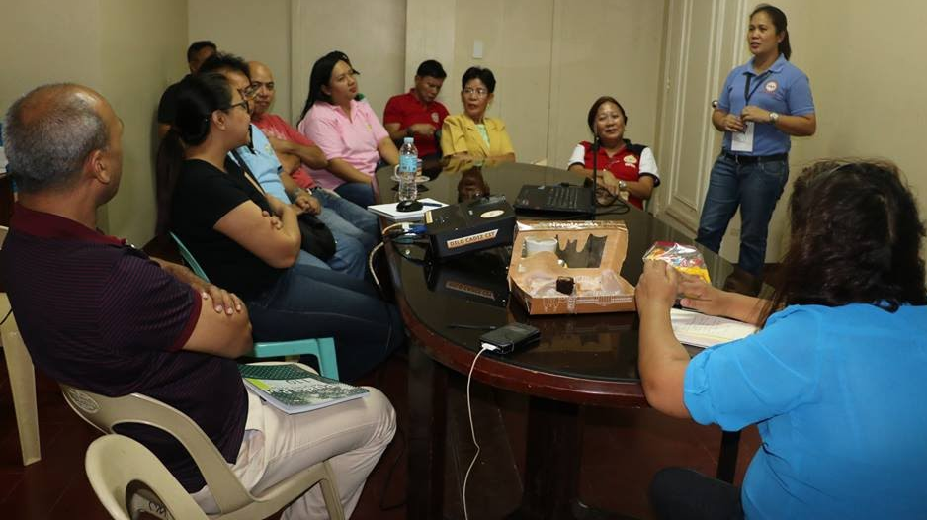
2.4 Orientation on DRR and Climate Change Adaptation
Refresher on International Commitments on DRR and Climate Change (Sendai Framework, Paris Agreement etc)
Review of National Laws on Disaster Risk and Climate Change
Check best practices instituted by other communities
Cadiz City Government, 2016
Notes:
To ensure that everyone is ‘on the same page’, the members of the technical working group should undergo a ‘refresher’ on the concepts of disaster risk reduction and climate change adaptation.
A review of existing policies and protocols should also be undertaken. The members should look at the best practices / initiatives set by other local government units and study how the learning can be applied in the community.

Slide 18
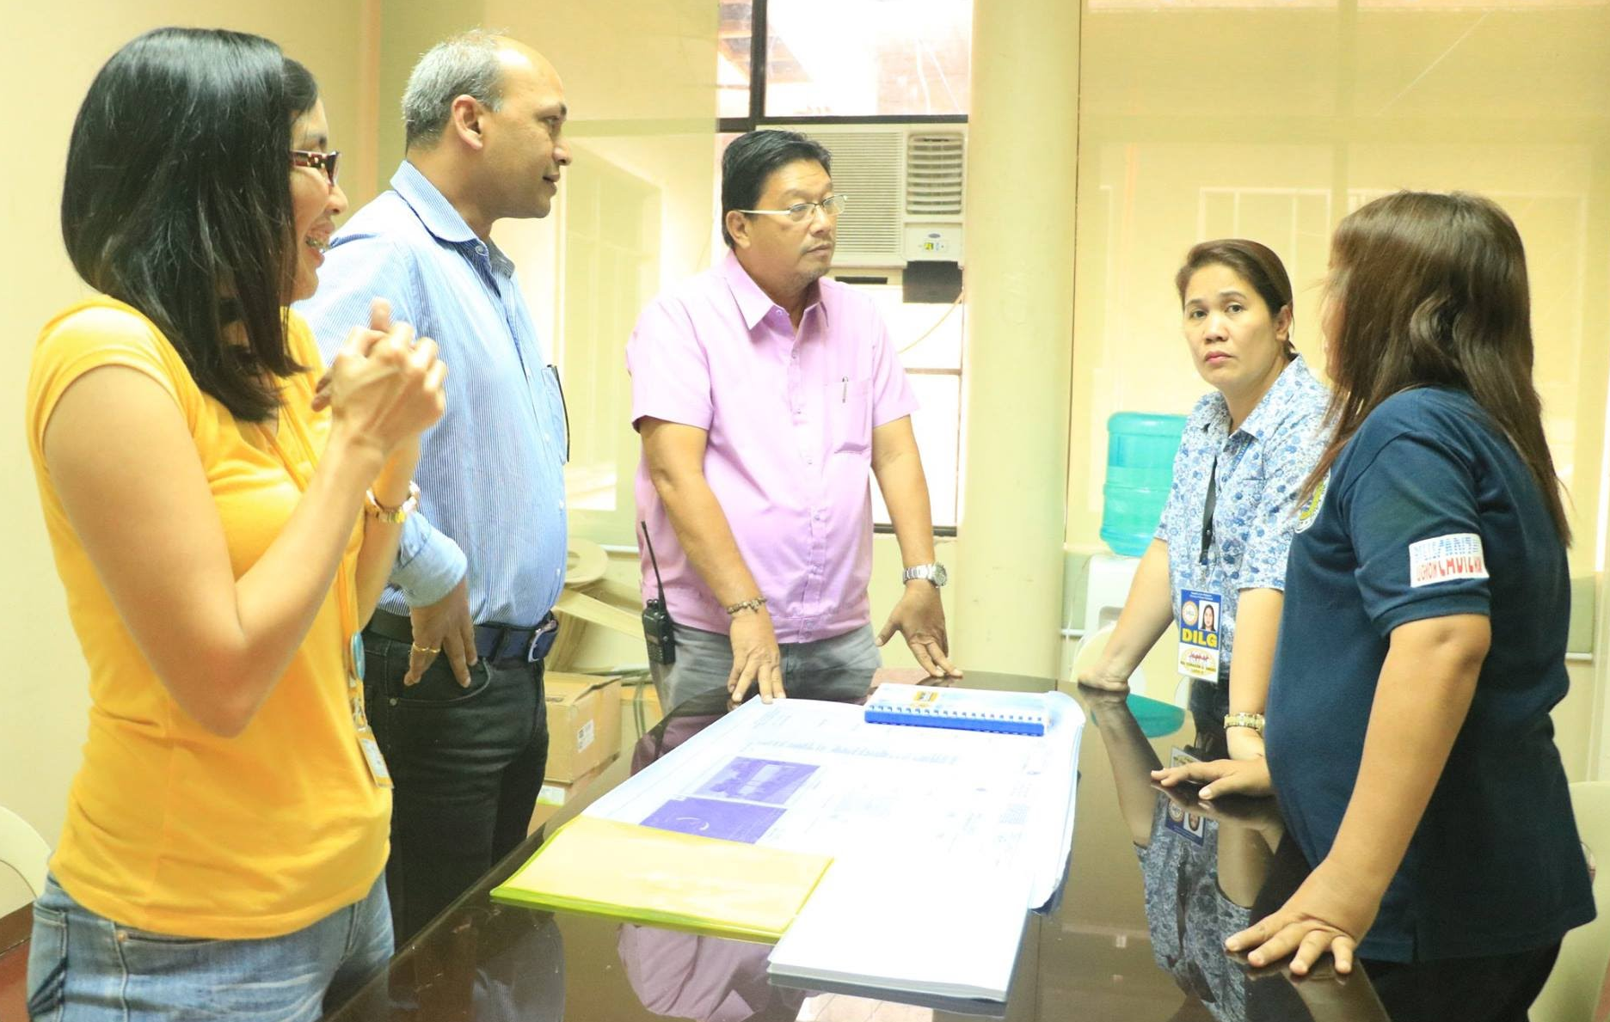
2.5 Review previous DRR Plans
Assess the last Disaster Risk Reduction and Management Plan
Check for consistency with other local government plans and national/regional policies
List issues and gaps in implementing the DRR plan
Cadiz City Government, 2016
Notes:
Another important step in the preparation of the disaster risk reduction plan is the assessment of the previous version. A SWOT (Strengths, Weaknesses, Opportunities and Threats) Analysis can be done to reveal the practices that works and can be continued, issues / gaps that needs to be addressed, and additional work that needs to be done.

Slide 19
2.6 Work Plan & Timeline
Orientation: on DRR and CCA to Local DRR Council Members
(Month 1)
Workshop: Participatory Capacity and Vulnerability Assessment
(Month 3)
Presentation of Community Risk Assessment and its Local Risk Patterns to the Technical Working Group (Month 4)
Set up Technical Working Group and Create Work Plan
(Month 1)
Development of Comprehensive DRR-CCA Projects and Fund Utilisation
(Months 5 & 6)
Revisions and finalisation of plan, Approval & Legislation
(Months 8 & 9)
Presentation of Draft Plan to Local Council Members
(Month 7)
Consolidation of TWG outputs per thematic area
(Month 4)
Notes:
The Technical Working Group and Advisory Panel should commit to a timeline that identifies the activities and their corresponding duration. Given the numerous tasks each department/office/organisation have, it is important to agree to a common schedule were stakeholders can actively participate.
In the development of the plan, consult with the national agencies in charge of disasters and climate change planning if they require to specific formats. In the Philippines, the Office of Civil Defense (OCD) has recently required that DRR plans follow a certain format. The Climate Change Commission (CCC) also requires that programmes, projects and activities follow the agency’s typology to identify proper budget allocation. Ideally, the DRR and CCA plans must be submitted and checked by OCD and CCC prior to the approval and legislation of the City Council.

Slide 20
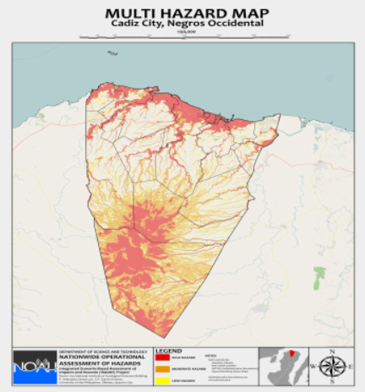
2.7 Preparation of ecological profile and socio-economic,
hazards, vulnerability data
Socio-Economic datasets
Disaggregated Population (by age, sex, spatial distribution)
Malnourished Children
Persons with Disability
Informal Settlements
Materials Used in Dwelling Units
Poverty
Land-Use Zones
Location of Physical Infrastructure
Project NOAH, 2016
Notes:
Various socio-economic datasets can be sourced from various departments in the local government. For example:
Disaggregated population data can be sourced from Local Civil Registry
Malnourished Children datasets from the Local Health Office and School Districts
Land-use zones from the Planning and Development Office
Infrastructures from Building/Engineering Official
Censuses, Community-based Monitoring Surveys and other official statistics issued by different government agencies can also be used. For the Philippines, census and statistical datasets from the Philippine Statistical Authority can be accessed for free via http://openstat.psa.gov.ph/
Hazard maps can be requested from the concerned national government offices and hazard warning agencies (usually the national Disaster and Emergency Bureau, Weather and Geological Mapping agencies, etc). For the Philippines, hazard maps can be downloaded via the repository of the Nationwide Operational Assessment of Hazards (http://noah.up.edu.ph/downloads/ )
It is recommended that datasets are sourced at the local level as much as possible to ensure accuracy, timeliness, validity and customization to the needs of the local government. In case of the absence of datasets sourced at the local/regional/national level, you can take a look at the datasets from the National Aeronautics and Space Administration (http://sedac.ciesin.columbia.edu/data/sets/browse)

Slide 21
3. Preparing the disaster risk reduction and climate change adaptation plan

Slide 22
3.1 Overview of activities
Visioning Exercise
Climate and Disaster Risk Assessment
        Hazard Characterisation
        Exposure and Potential Damage Estimation
        Vulnerability and Capacity Assessment
        Identification of measures to reduce vulnerability and enhance capacity

Slide 23
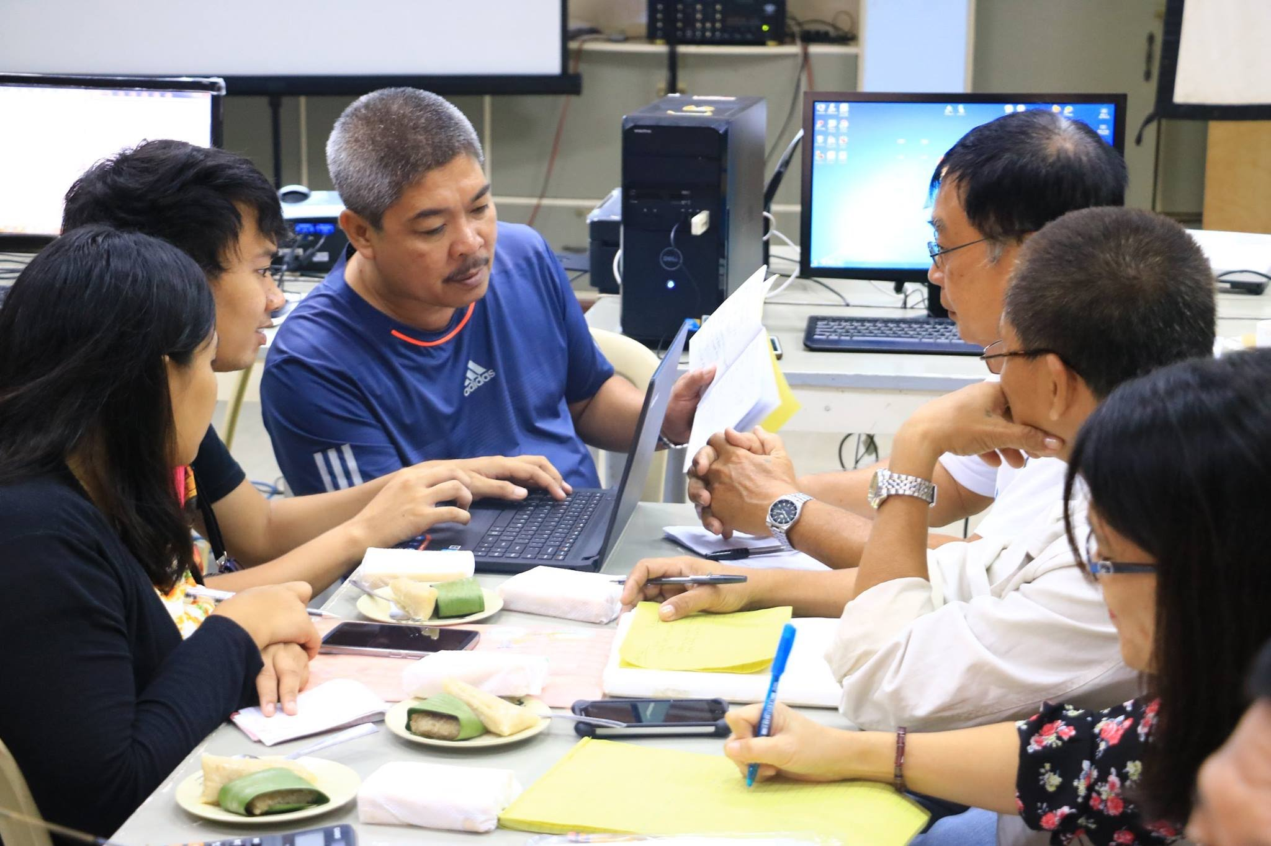
3.2 Visioning Exercise
MAJOR AREAS | CURRENT SITUATION | DESIRED STATE IN FIVE YEARS
Environment and Natural Resources
Institutional Sector
Social Sector
Local Economy
Physical Infrastructure
Cadiz City Government, 2016
Notes:
Like other development plans the DRR plan begins with a vision statement. To identify potential gaps in implementation, it is helpful to conduct a vision-reality gap exercise to assess the current situation and the desired state of the city or municipality
If the vision of city or municipality is related to resilience, it is important to develop its own indicators. As it stands, there are no standard resilience indicators for the Philippines but there are numerous references from various INGOs, NGOs, and academic publications.
The table serves as a template that can be filled out during the exercise. Please take note that the disaster risk reduction plan should be time-bound. It’s typically prepared for the medium-term (around 5 years).

Slide 24
3.3 Hazard Seasonality Calendar
Hazard | Jan | Feb | Mar | Apr | May | Jun | Jul | Aug | Sep | Oct | Nov | Dec
Notes:
One of the activities in workshops involving the Technical Working Group is the creation of the Hazard Seasonality Calendar. This will serve as a basis in pinpointing hazards that pose the greatest danger in the community and in prioritising the mitigation and preparedness activities to be laid out in the plan.
By using the template above, workshop participants should recall and list the hazards they have experienced in the community. This should also identify the months when they happened. It would be helpful if they could note the last and worst hazard scenarios they experienced and their corresponding impacts.

Slide 25
3.4 Hazard Characterisation
Hazard | Probability Score | Impact Score | Average Score | Rank | Remarks
Notes:
As a follow-up to the Hazard Seasonality Calendar, the Hazard Characterisation activity will try to assign scores in probability and expected impacts (usually in a scale of 1 to 5 with 5 being the highest). The more frequent the hazard, the higher the ranking in the Probability Score. The higher the expected losses the hazard can bring, the higher the Impact Score.
The hazards will then be ranked according to their Average Probability and Impact Score. The higher the average score, the higher the priority of the hazard in creating disaster mitigation and prevention action plans.

Slide 26
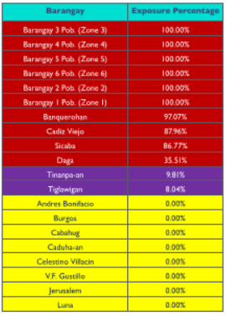
3.5 Exposure and Potential Damage
Hazard Map
Exposure Dataset
Notes:
By using Geographic Information Systems (GIS), hazard maps should be intersected with each of the exposure datasets (eg. land uses, residents, physical infrastructure and natural resources). The GIS software can automatically generate tables, lists and maps that compute for the percentage of exposure. An array of GIS software is available for use such as ArcGIS (commercial license) and qGIS (freeware and open source).
Please refer to the thresholds set by the national government to classify the exposure as either High, Moderate or Low.

Slide 27
3.6 Vulnerability and Capacity Assessment
Vulnerabilities | Capacities
Should include current gaps and envisioned damages and adverse impacts of identified hazards to each of the sector Examples: Lack of inter-agency coordination Erosion of social order Inadequate facilities (eg. Hydrants) Possibility of isolation of some communities due to lack of insufficient transport network Threats to loss of farming and fishing implements | Should include available equipment, facilities and infrastructure, established processes, existing institutions and social capital Examples: Strong sense of community, especially in religious groups Existing partnerships with civil society organisations Dams and controlled irrigation systems Availability of pre-positioned emergency transport facilities Access to crop insurance
Notes:
A separate workshop focusing on vulnerability and capacity should also be undertaken.
This involves an inventory of available resources, protocols and infrastructure.

Slide 28
3.7 Identification of measures
Should include steps and actions needed to address vulnerabilities and gaps
Examples:
Expansion of social security coverage
Improving access to loan and credit facilities
Installation of early warning devices
Instituting standard operating procedures for evacuation of communities to safe areas
Enforcement of Solid Waste Management Act
Roll-out of Information and Education Campaigns
Notes:
Gaps identified through the Visioning Exercise and in the Vulnerability and Capacity Assessment should be used as a basis for creating action plans to achieve the desired results.

Slide 29
4. Implementing the disaster risk reduction plan

Slide 30
4.1 Overview of activities
Strengthening the Local Disaster Risk Reduction & Management (DRRM) Office
Ensuring Guidance from Other Disaster Plans
Declaring State of Calamity/Emergency
Allocation of Financial Resources
Mainstreaming disaster risk reduction with other local plans
Instituting monitoring and evaluation mechanisms
Fostering institutional arrangements, linkages, partnerships and networks
Introducing proposals for more detailed studies
Lobbying national government for projects and policy changes for disaster prevention and mitigation

Slide 31
4.2 Strengthening of Local DRRM Office
An organisational chart should be created to delineate hierarchy and responsibilities in implementing different tasks identified in the disaster risk reduction plan
Local Chief Executive
Local DRRM Officer
Administrative Division
Training Division
Operations and Early Warning Division
Research and Planning Division
Logistics Division

Slide 32
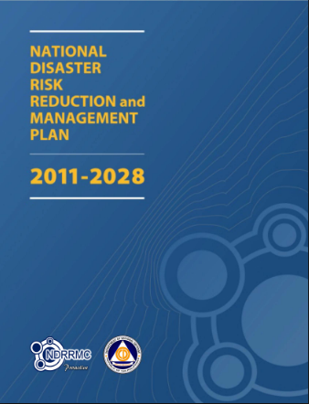
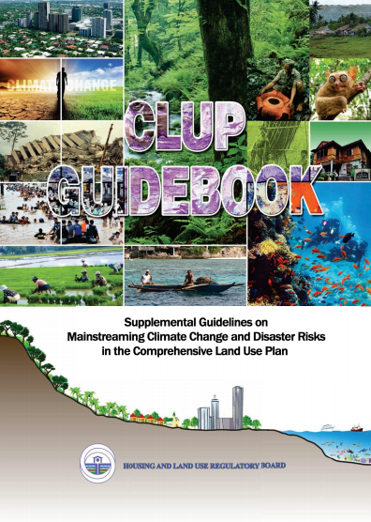
4.3 Ensuring Guidance from Other Government Plans
Office of Civil Defense, 2011
Housing and Land Use
Regulatory Board, 2015
Notes:
Revisit the Initial Review conducted and the measures Identified to ensure compatibility with other government plans.

Slide 33
4.4 Declaring the State of Emergency
“...a condition involving mass casualty and/or major damages to property, disruption of means of livelihoods, roads and normal way of life of people in the affected areas as a result of the occurrence of natural or human-induced hazard”
Philippine Disaster Risk Reduction & Management Act (2010)
Declared by the local government council based on the recommendation of the local disaster risk reduction and management office
Triggers remedial measures such as imposition of price ceiling on basic necessities and prime commodities, programming of funds for the repair of public infrastructure and facilities, granting of no-interest loans to affected sectors etc
Notes:
Establish a set of protocols to be followed for the declaration of emergency, as guided by the applicable laws.
Specific action plans should also be developed and be designated to appropriate offices/departments to ensure accountability and efficiency in implementing the plan.

Slide 34
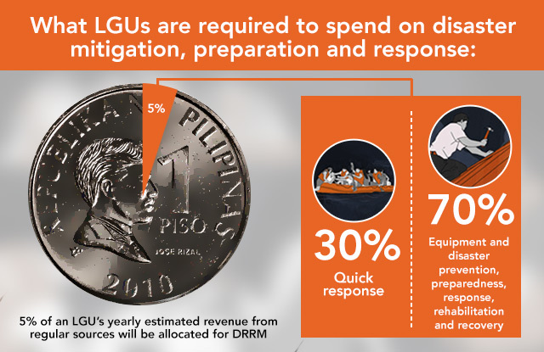
4.5 Allocation of Financial Resources
Rappler, 2016
Notes:
Based on the results of the Visioning Exercise, Hazard Characterisation, Vulnerability and Capacity Analysis and Identification of Measure workshop, activities should be listed and be allocated financial resources.
Budget allocations should be compliant with existing laws and regulations pertaining to the disaster risk reduction & management fund.

Slide 35
4.6 Mainstreaming DRR with other local plans
Information from the DRR plan should inform, be integrated and be harmonised with other plans prepared at the local community level. These may include:
Annual Investment Plan
Comprehensive Development Plan
Comprehensive Land Use Plan
Local Climate Change Adaptation Plan
Notes:
One of the biggest tasks is this process is the mainstreaming of the disaster risk reduction and management plan. The technical working group should be assertive in ensuring that other plans to be developed by the local government should be informed by the datasets, action plans and analysis in the DRRM plan.

Slide 36
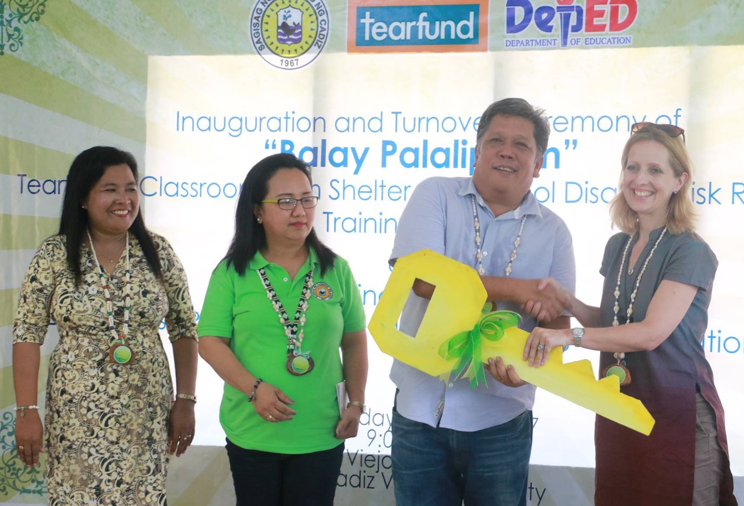
4.7 Fostering institutional arrangements, partnerships, linkages & networks
Who is typically involved?
Civic Society Organisations
Academic and Research Institutions
Neighbouring Local Government Units
National and Regional Government Agencies
Cadiz City Government, 2017
Notes:
To ensure community involvement and continuous improvement of the DRRM plans, various partnerships can be developed with other organisations and institutions.

Slide 37
4.8 Other Activities
Instituting monitoring and evaluation mechanisms
Introducing proposal for more detailed studies (if necessary)
Lobby national government for projects and policy changes

Slide 38
5. Monitoring & Evaluation

Slide 39
5.1 Importance of Monitoring & Evaluation
Monitoring and evaluation should be an ongoing process and should form an important part of the entire planning cycle.
What to include?
  Effects of the utilisation of the outputs produced (project outcomes)
  Contribution of the outputs to the realisation of development goals (project impacts)
  Determination of impacts of public sector planning interventions (programs, projects, services and regulatory measures); and impacts of private sector investments on the local area and population

Slide 40
For more information please contact humanitarian.support@tearfund.org

